Slide 1
Basic Java

Slide 2
Agenda
Keyword
Data Types
Variables
If and Switch
Loops
Break and Continue
Function
24/05/2021
Basic Java
2

Slide 3


Introduction
Java is an object oriented programming language.
Java is one of the programming language used for Android Development.
So let’s get started.

Slide 4
Keyword

Slide 5
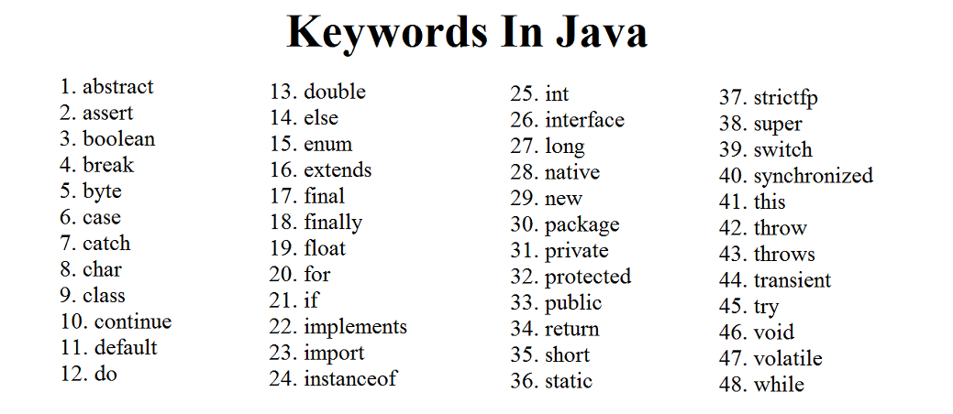
Keyword
Java has a set of keywords that are reserved words that cannot be used as variables, methods, classes

Slide 6
Data Types

Slide 7
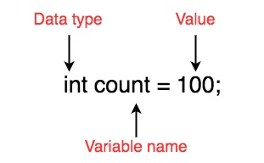
Data Types
Data types specify the different sizes and values that can be stored in the variable.
There are 6 main types of primitive data types:
boolean data type
char data type
int data type
long data type
float data type
double data type

Slide 8
Variables

Slide 9
Variable
A variable is a container which holds the value.
Rules for naming a variable:
All variables should begin with a letter (A to Z or a to z), currency character ($) or an underscore (_).
A keyword cannot be used as an identifier.

Slide 10
If and Switch

Slide 11
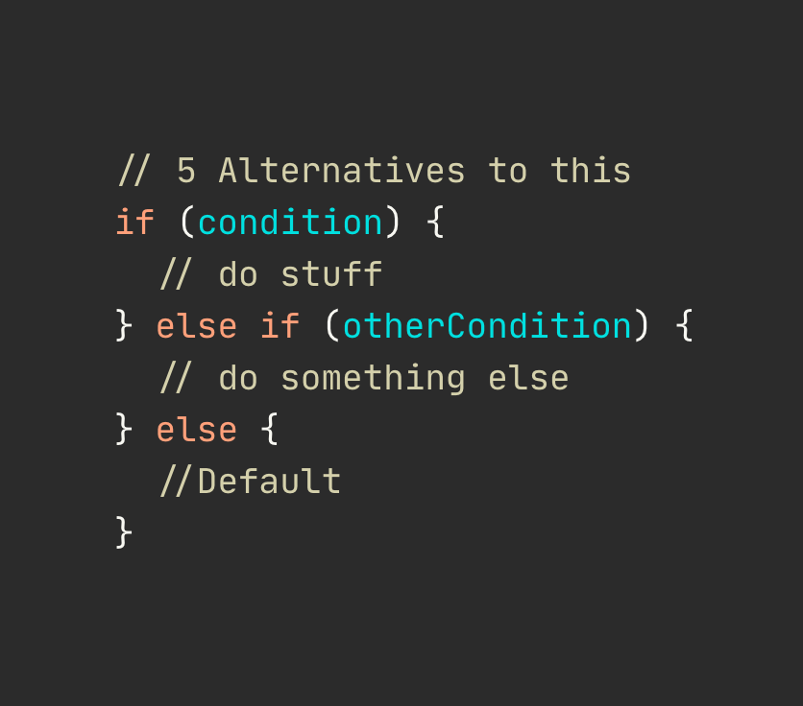
If Condition
The Java if statement is used to test the condition.
It checks boolean condition: true or false.
Types of if’s:
if statement
if-else statement
if-else-if ladder

Slide 12
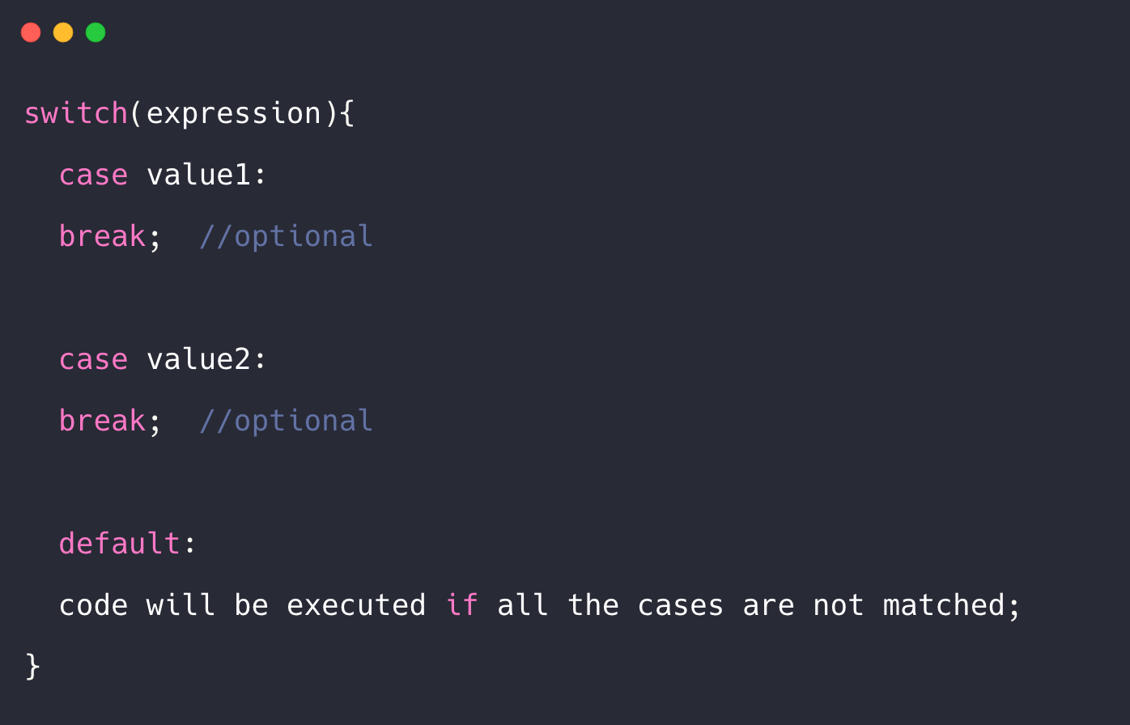
Switch Statement
The switch statement tests the equality of a variable against multiple values.

Slide 13
Loops

Slide 14
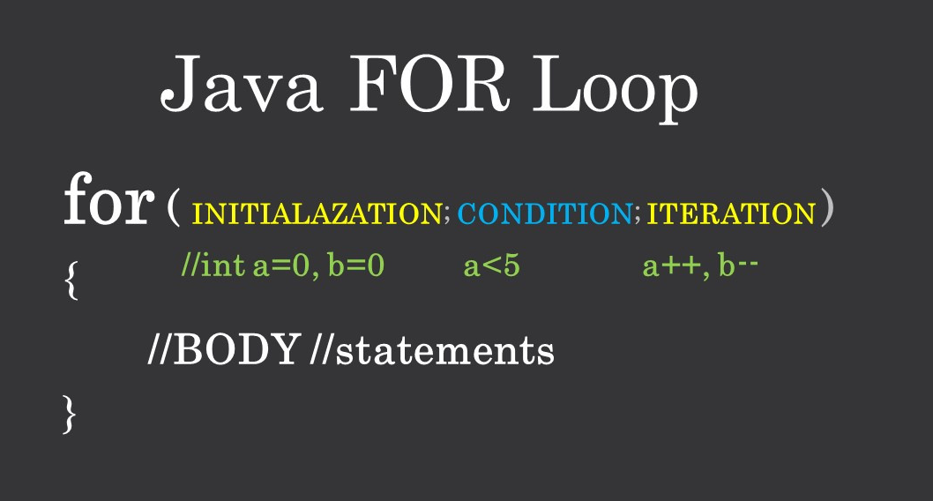
For Loop
The Java for loop is used to iterate a part of the program in fixed number of times.

Slide 15
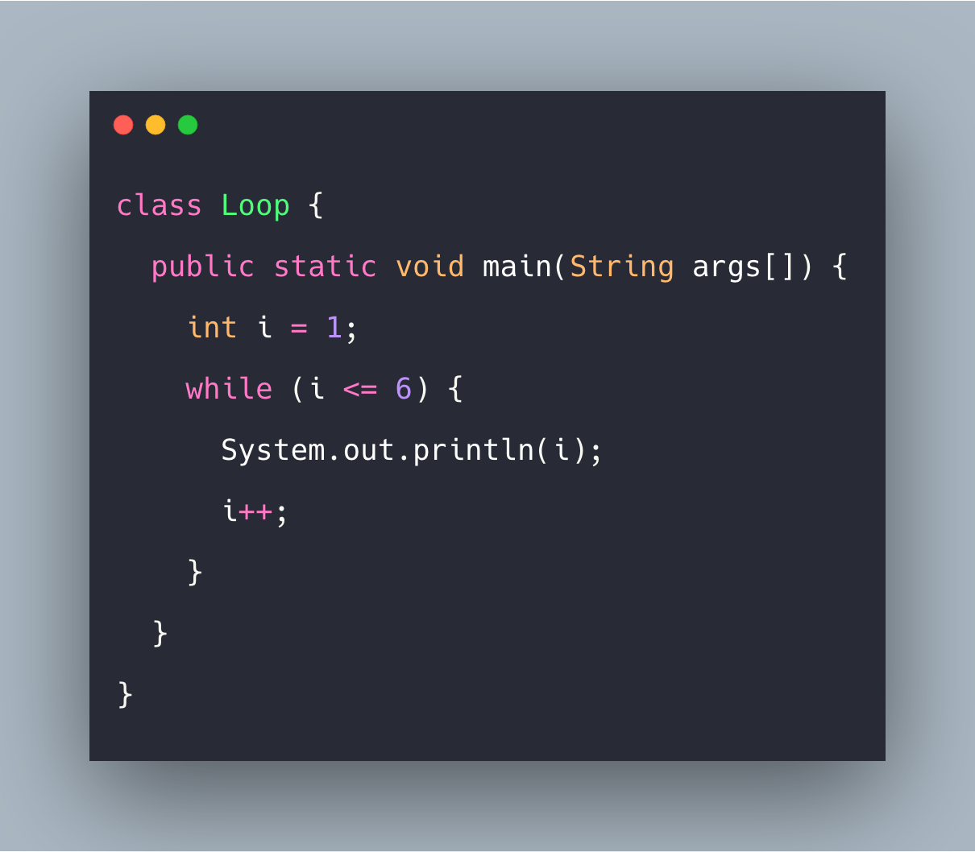
While Loop
The Java for loop is used to iterate a part of the program in number of times but not fixed.

Slide 16
Break & Continue Keyword

Slide 17
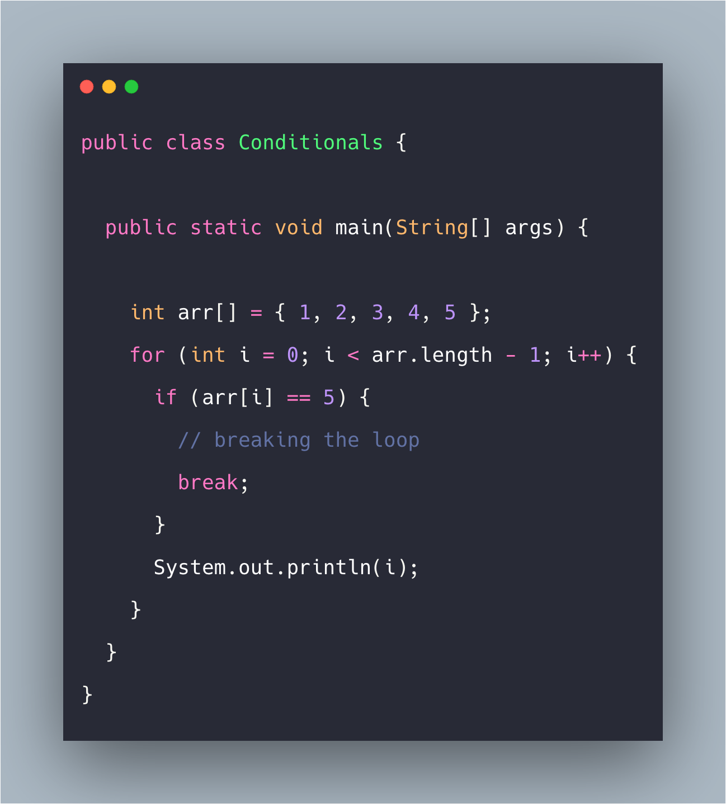
Break Keyword
When a break statement is encountered inside a loop, the loop is immediately terminated

Slide 18
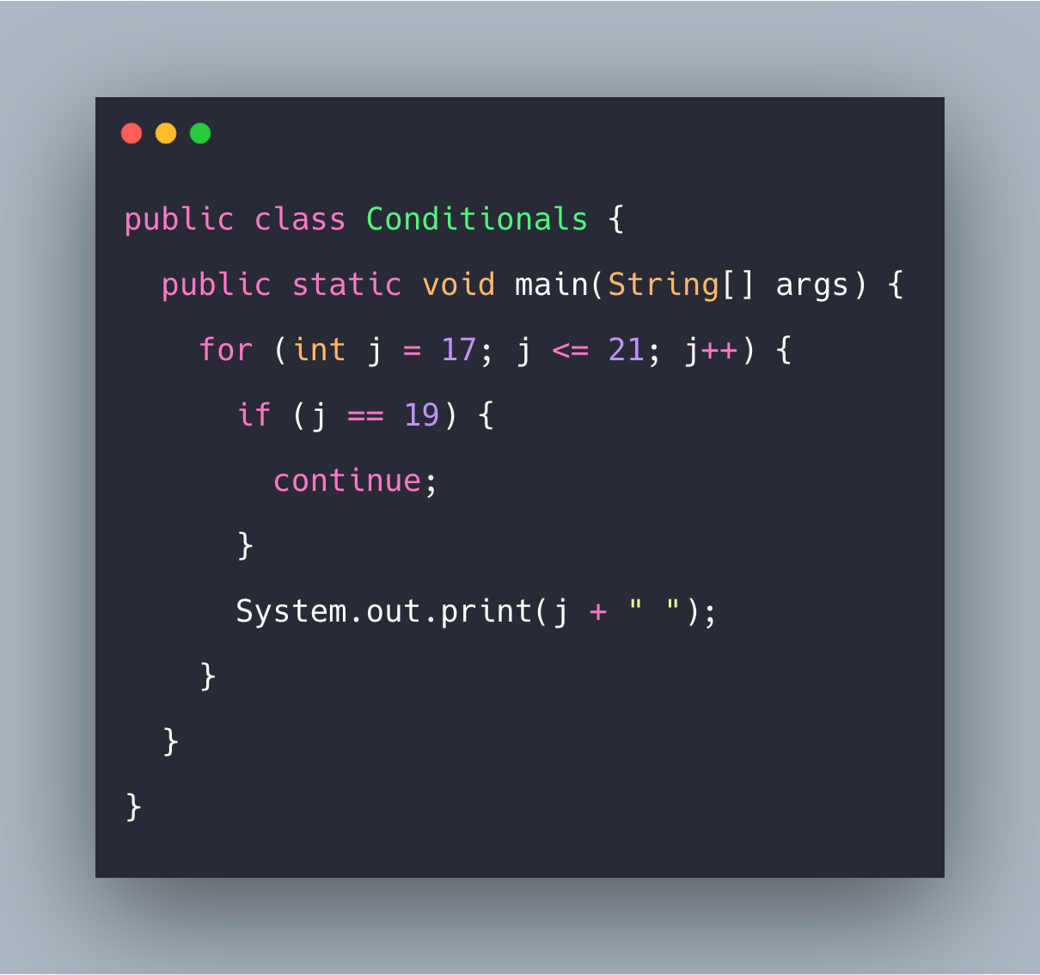
Continue Keyword
When a break statement is encountered inside a loop, the loop is immediately terminated

Slide 19
Function

Slide 20
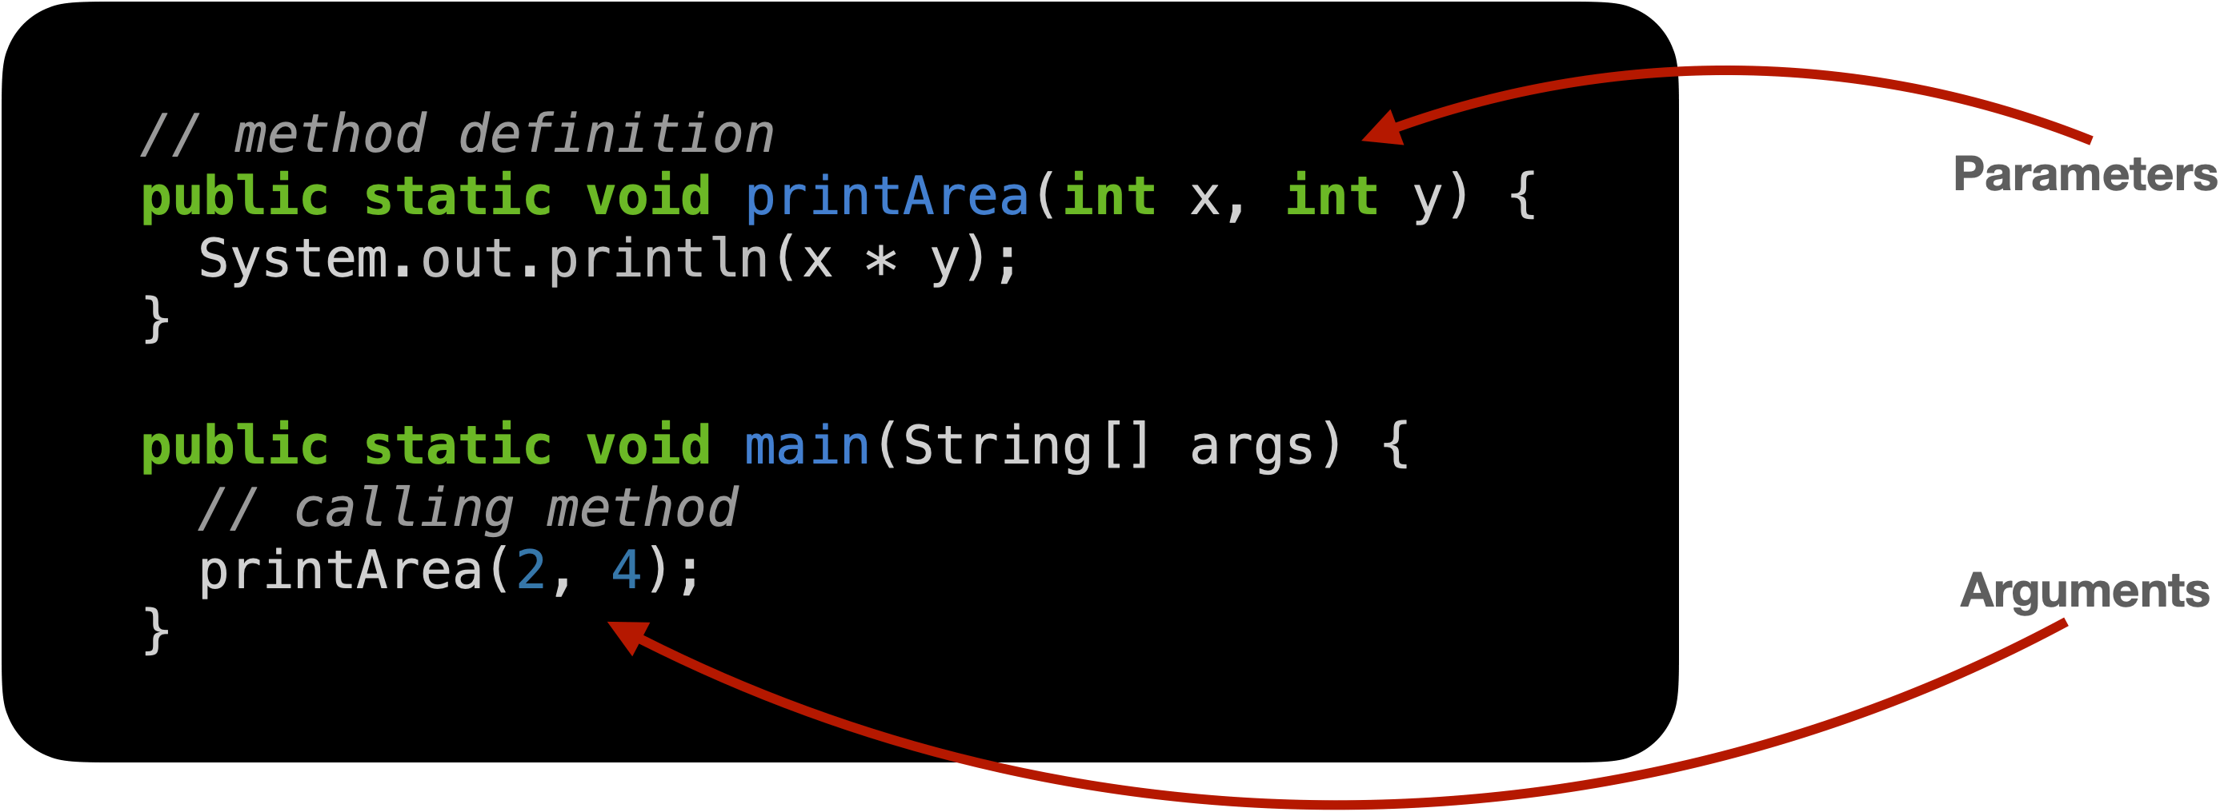
Function
Function is a piece of code which performs the operation and sometimes returns a value.
All function definitions must be inside classes.
Parameter can be 0 or more.
If it has return statement then, void should be replaced with datatype of the returning value.

Slide 21
Thank you

